Slide 1
Intro to Java (Page 9)
JUMP June 2019
Draft: 07/26/2019

Slide 2
Table of Contents
JAR files
Collections
Difference Between Arrays and Collections in Java

Slide 3
JAR Files
A JAR (Java ARchive) is a package file format typically used to aggregate many Java class files and associated metadata and resources (text, images, etc.) into one file for distribution. ... They are built on the ZIP format and typically have a .jar file extension.

Slide 4
JAR Files
Steps to Creating a Java Project, and a simple Class
Create a Java Project “JARProjectToExport”
Create a package name: “jardemopackage”
Create a class name: “Dice” inside the “jardemopackage”
Add the following content to the Dice Class
Creating a Jar File
In Java, it is common to combine several classes in one .jar ("java archive") file. Library classes are stored that way. Larger projects use jar files. You can create your own jar file combining several classes, too.
jar files are created using the jar.exe utility program from the JDK.
Most IDEs like STS allows you to export your project as a JAR file as well.
Note: If you don’t make the class and the method “public”. The package will be useless
package jardemopackage;
public class Dice {
public Dice() {
}
public int getDice() {
return (int) (Math.random() * 6) + 1;
}
}

Slide 5
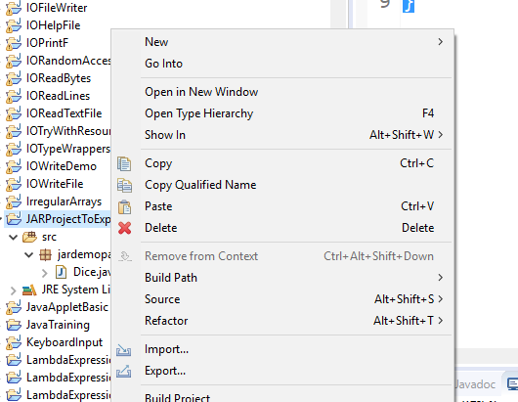
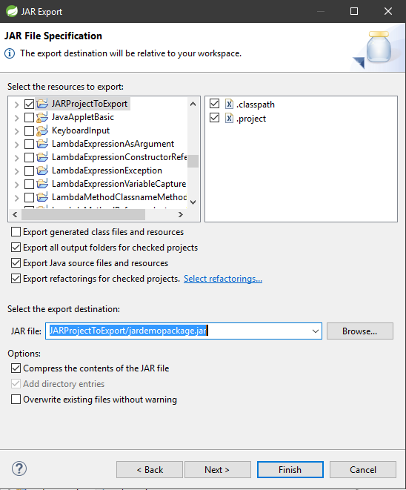
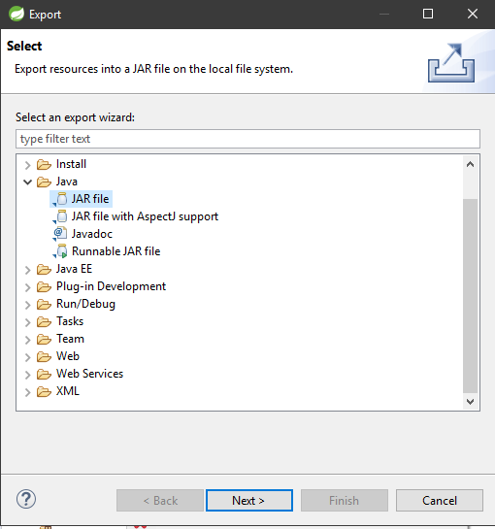
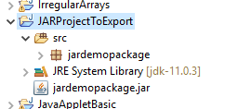
JAR Files
Exporting the Project as a JAR file using STS
Use the context-menu on the project and select “Export”
Select “JAR file” from the JAVA folder
Click Next >
For our scenario, the options preselected are correct. Notice the “Select the resources to export”, in theory, if you had dependencies between projects, you would be able to export them all as one single JAR file.
Pay attention to the “Select the export destination” because this is where the JAR file will be created and stored. Provide a folder/name which makes sense.
Click “Finish”
Should have a JAR file

Slide 6
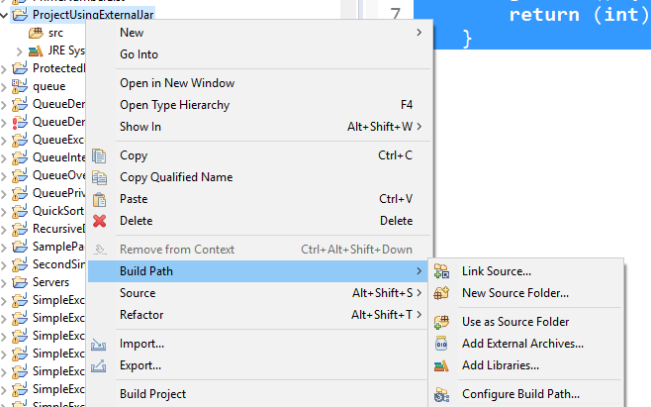
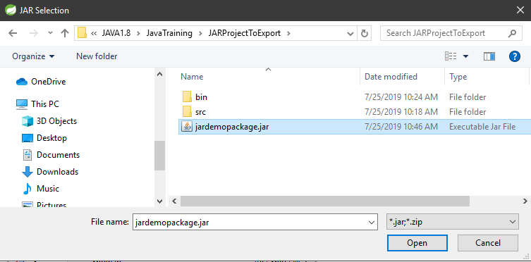
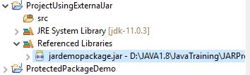
JAR Files
Using a JAR file into a project
Create a Java Project “ProjectUsingExternalJar”
Using the context-menu on the project, select Build Path > Add External Archives
Find the JAR file that was exported for this demo and click “Open”
Create a Main class in your src (it will create a default package)
Main.java
import jardemopackage.*;
import jardemopackage.Dice.*;
public class Main {
public static void main(String[] args) {
Dice d = new Dice();
System.out.println("First Throw: " + d.getDice());
System.out.println("Second Throw: " + d.getDice());
}
}

Slide 7
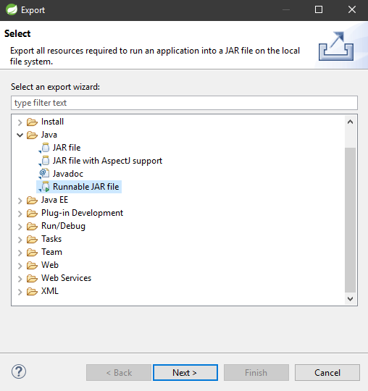
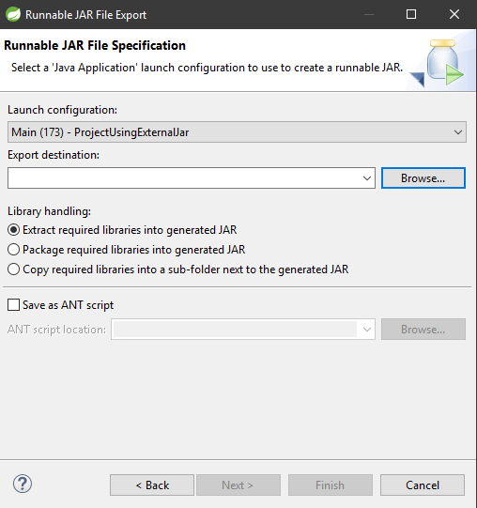
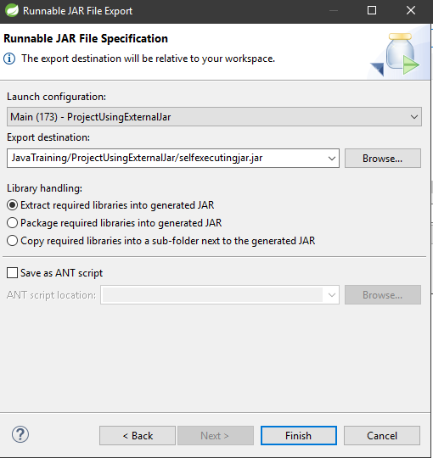
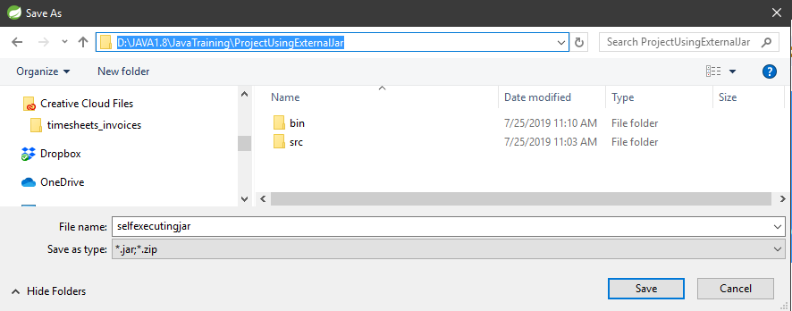
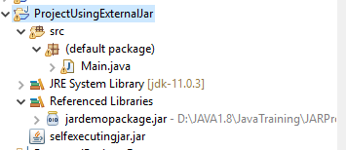
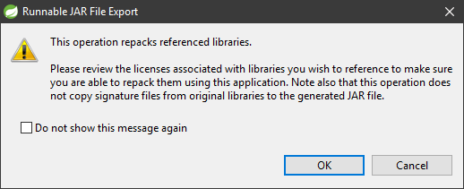
JAR Files
Note: if you haven’t executed the file, your Launch Configuration will not provide the proper class/project info.
Create a Self-Executing Jar
Using the Java Project “ProjectUsingExternalJar”
Use the context-menu on the project and select “Export”
Select “Runnable JAR file” from the JAVA folder
Click Next >
Ensure your “Launch Configuration” selection is based on your Main class for your project
Click the “Browse” button and ensure you type as a file name “selfexecutingjar” and ensure your path is in your ProjectUsingExternalJar folder
Click Save
This brings you back to the Runnable JAR File Export dialog box
Keep all other options as is and “Finish”
Click OK for this warning

Slide 8
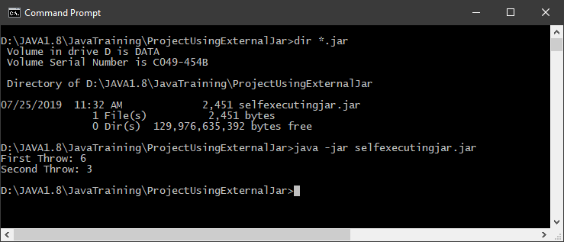
JAR Files
Running a Self-Executing JAR file
Locate the directory of your jar file to execute using a cmd / terminal window.
>java –jar name_of_jar_file Note: on mac/linux, may need to use a “sudo” prefix

Slide 9
Collections
The Collection in Java is a framework that provides an architecture to store and manipulate the group of objects.
Java Collections can achieve all the operations that you perform on a data such as searching, sorting, insertion, manipulation, and deletion.
Java Collection means a single unit of objects. Java Collection framework provides many interfaces (Set, List, Queue, Deque) and classes (ArrayList, Vector, LinkedList, PriorityQueue, HashSet, LinkedHashSet, TreeSet).
What is Collection in Java
A Collection represents a single unit of objects, i.e., a group.
What is Collection framework
The Collection framework represents a unified architecture for storing and manipulating a group of objects. It has:
Interfaces and its implementations, i.e., classes
Algorithm

Slide 10
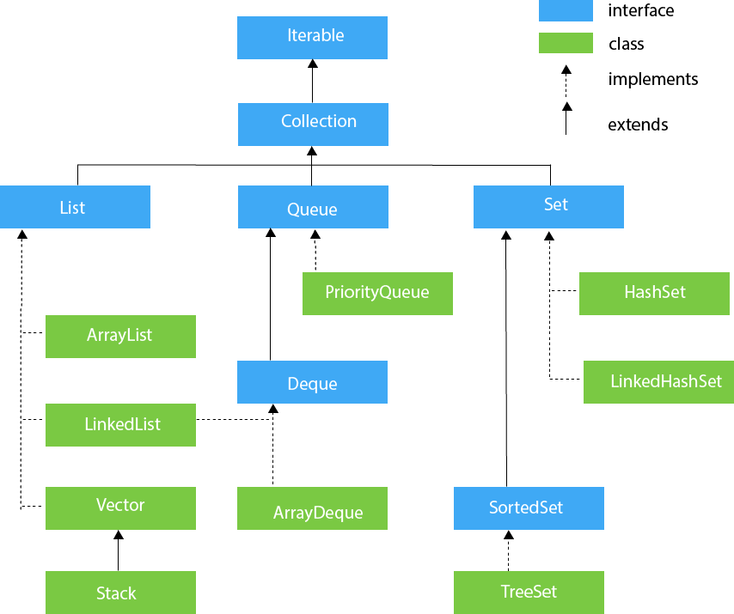
Collections
The hierarchy of Collection framework.
The java.util package contains all the classes and interfaces for the Collection framework.
https://www.javatpoint.com/collections-in-java

Slide 11
Collections
Projects List and Links
CollectionArrayList - https://beginnersbook.com/2013/12/java-arraylist/
CollectionLinkedList - https://beginnersbook.com/2013/12/linkedlist-in-java-with-example/
CollectionVector - https://beginnersbook.com/2013/12/vector-in-java/
CollectionStack - https://www.callicoder.com/java-stack/
CollectionPriorityQueue - https://www.callicoder.com/java-priority-queue/
CollectionPriorityQueueComparator - https://www.callicoder.com/java-priority-queue/
CollectionArrayDeque - https://www.geeksforgeeks.org/arraydeque-in-java/
CollectionHashSet - https://www.callicoder.com/java-hashset/
CollectionHashSetFromAnotherCollection - https://www.callicoder.com/java-hashset/
CollectionHashSetSimpleOperations - https://www.callicoder.com/java-hashset/
CollectionHashSetRemoveElements - https://www.callicoder.com/java-hashset/
CollectionHashSetIteration - https://www.callicoder.com/java-hashset/
CollectionHashSetUserDefinedObjects - https://www.callicoder.com/java-hashset/
CollectionLinkedHashSet - https://www.geeksforgeeks.org/linkedhashset-in-java-with-examples/
CollectionTreeSet - https://www.callicoder.com/java-treeset/
CollectionTreeSetCustomComparator - https://www.callicoder.com/java-treeset/
CollectionTreeSetElementsAccess - https://www.callicoder.com/java-treeset/
CollectionTreeSetUserDefinedObjects - https://www.callicoder.com/java-treeset/

Slide 12
Difference Between Arrays and Collections in Java
The main advantage of Collection Framework are Collections are grow-able in nature, hence based on our requirement we can increase or decrease the size. Some others advantage are given below;
Collection is re-sizable or dynamically draw-able memory. (can be garbage collected)
Provides useful data structures in the form of predefined classes that reduces programming affords.
It support to store heterogeneous elements or object.
It provides higher performance.
It provides Extendibility (depends on incoming flow of data, if the size of collection framework variable is increasing than the collection framework variable is containing Extendibility feature).
It provides adaptability facility (The process of adding the content of one collection framework variable to another collection framework either in the beginning or in the ending or in the middle in known as adaptability).
It is one of the algorithmic oriented.
It provides in-built sorting technique.
It provides in-built searching technique.
It provides higher preliminary concepts of Data Structure such as:- Stack, Queue, LinkedList, Trees ..etc.

Slide 13
Difference Between Arrays and Collections in Java
Array | Collection
Arrays are fixed in size and hence once we created an array we are not allowed to increase or decrease the size based on our requirement. | Collections are grow-able in nature and hence based on our requirement we can increase or decrease the size.
Arrays can hold both primitives as well as objects. | Collections can hold only objects but not primitive.
Performance point of view arrays faster than collection. | Performance point of view collections are slower than array.
Arrays can hold only homogeneous elements. | Collections can hold both homogeneous and heterogeneous elements.

